Slide 1
FOREX
Zhihan Xue
Rishi Dutta
Shweta Tatiya
Amit Pingale
Madhuja Gosavi

Slide 2
Introduction on Forex Market
When investors trade forex —they’re buying and selling currencies over the foreign exchange market. It’s the largest financial market in the world but we in our case are considering few countries based on the stationarity and cointegration test. Since forex market is 24 hours we do not have any open close.
Y = UK: United Kingdom
Because forex is traded in pairs, you’re always exchanging one currency for another — buying one, selling the other
X = US,AL: Australia, US,SZ: Switzerland, US,EU: Europe

Slide 3
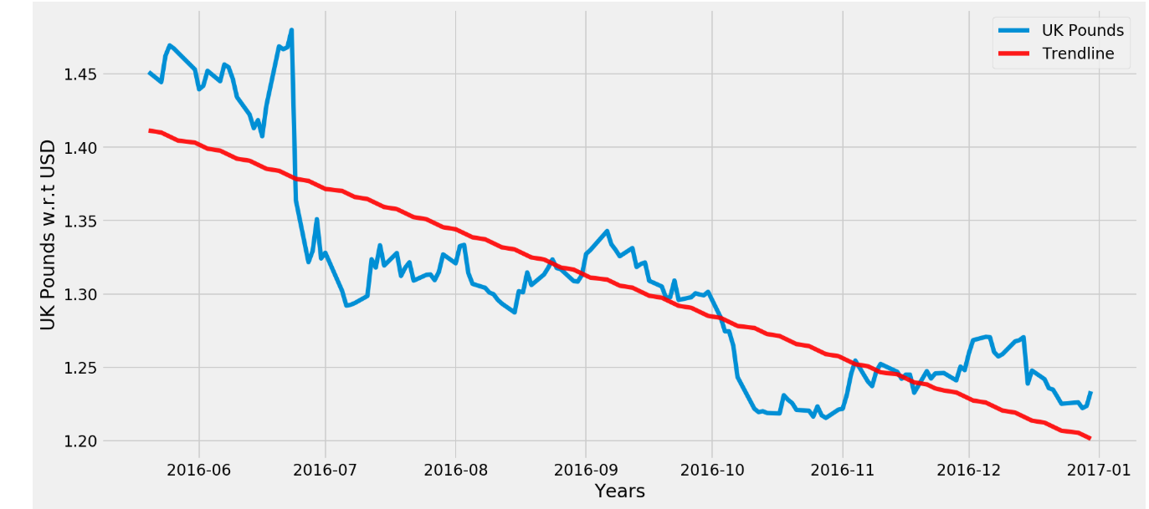
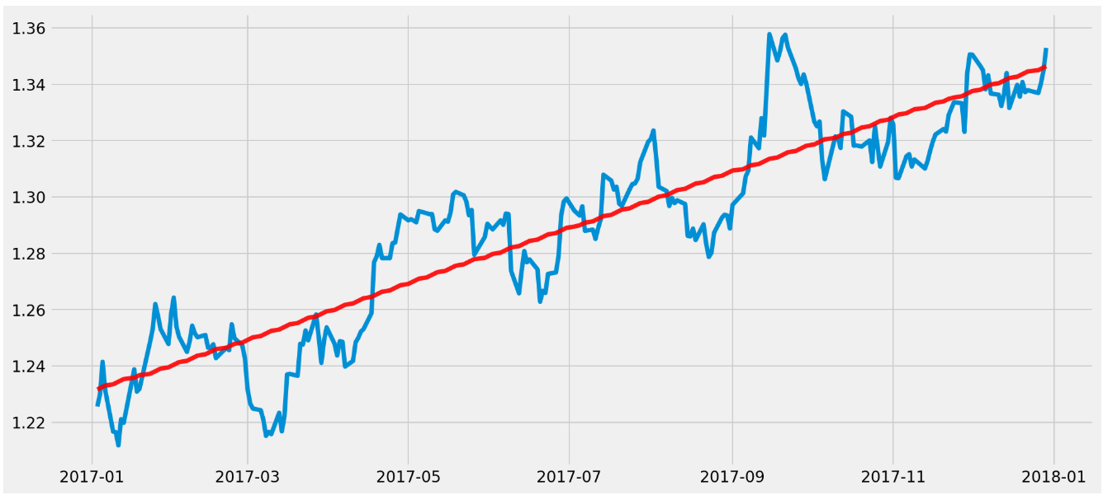
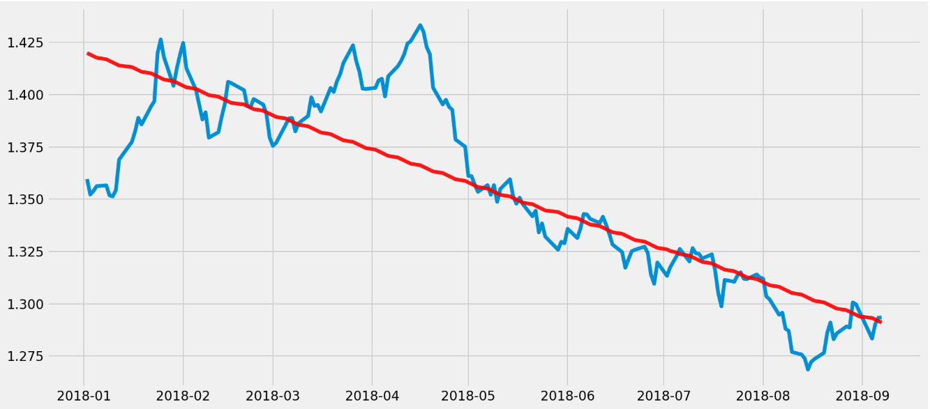
Momentum Drift Trend Lines:
Momentum indicators are:
Relative Strength Index (RSI)
Rate of change (ROC)
Stochastics.
Gross domestic product (GDP) is the monetary value of all the finished goods and services produced within a country's borders in a specific time period.

Slide 4
GDP for UK
2015 | 3.1%
2016 | 2.3%
2017 | 3.9%
2018 | 1.8%

Slide 5
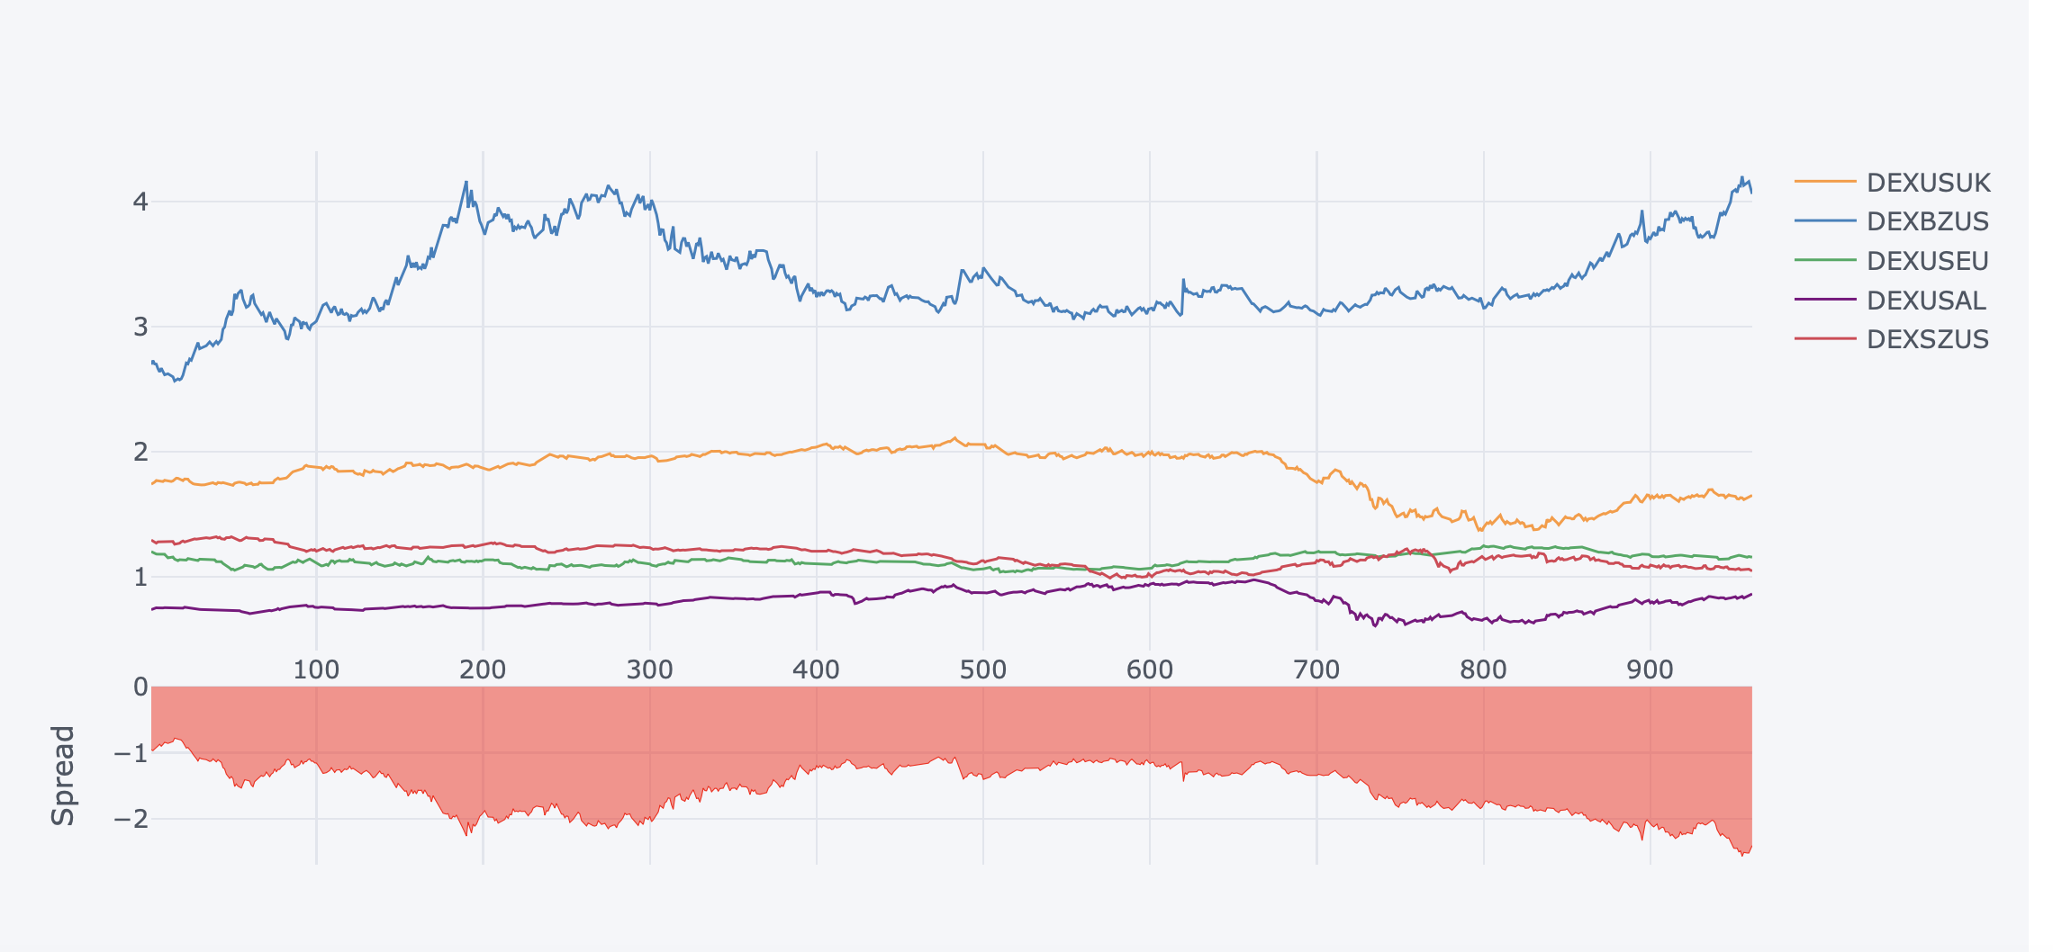
Analysis on forex currencies:

Slide 6
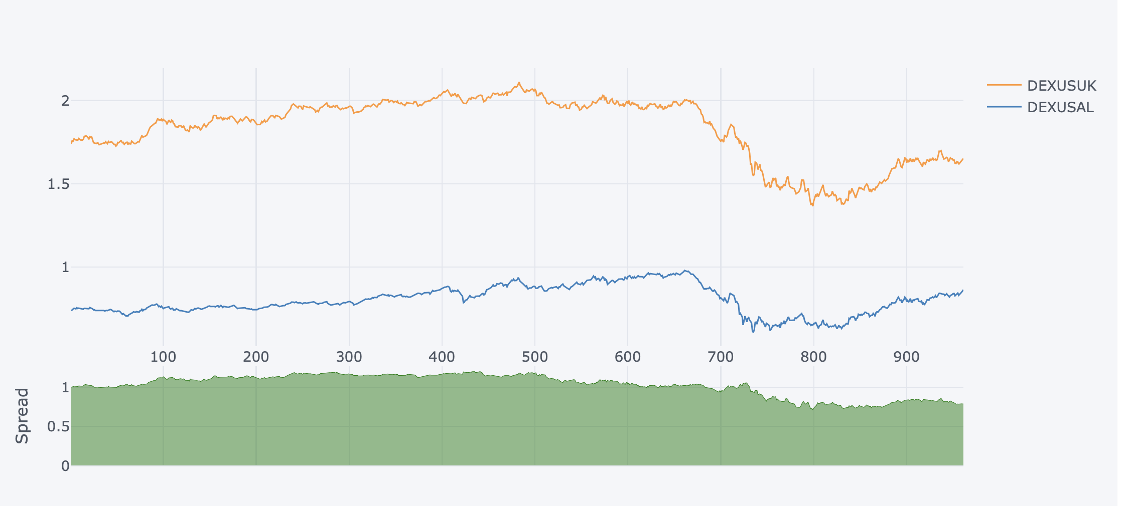
Pairs Trading with UK as target feature v/s Australia

Slide 7
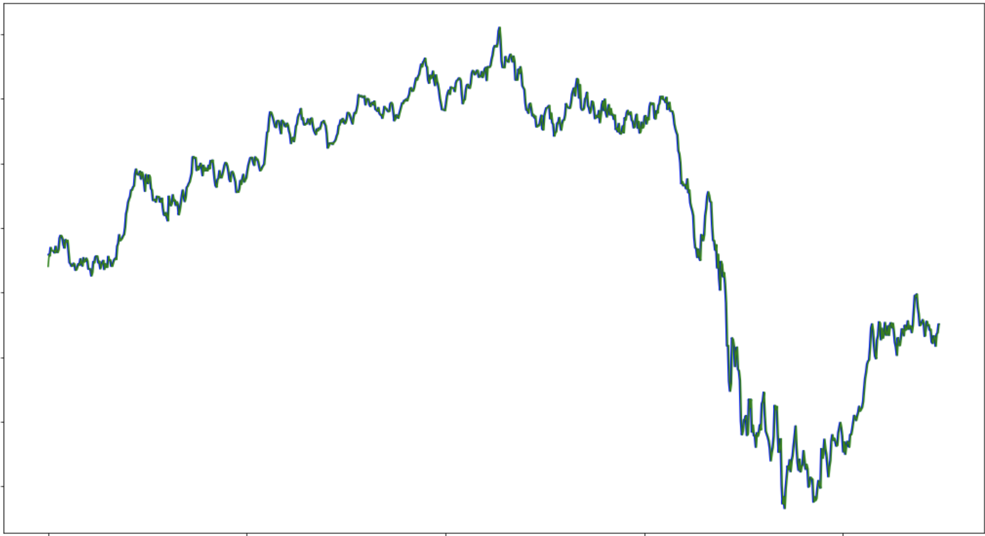
KALMAN FILTER -for price prediction

Slide 8
What is RSI?
Relative Strength Index - RSI is a momentum indicator that measures the magnitude of recent price changes to analyze overbought or oversold conditions. It is primarily used to attempt to identify overbought or oversold conditions in the trading of an asset.
RSI is considered overbought when above 70 and oversold when below 30.

Slide 9
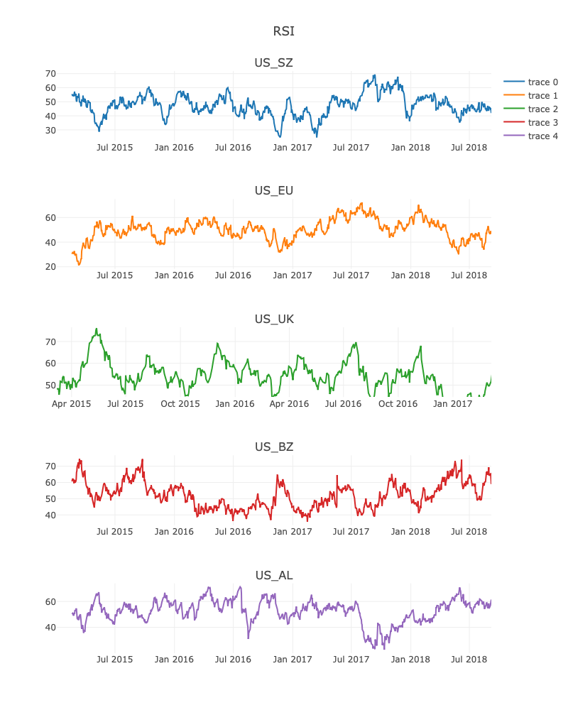
Relative Strength Index:

Slide 10
Principal Component Analysis
Used to reduce multi-collinearity
Reduces dimensionality by removing noise and redundancy
Use of Eigenvalues and Eigenvectors for computing PCA
Steps:
Performed scaling
Used eigenvalues and eigenvectors for reducing distortions in data

Slide 11
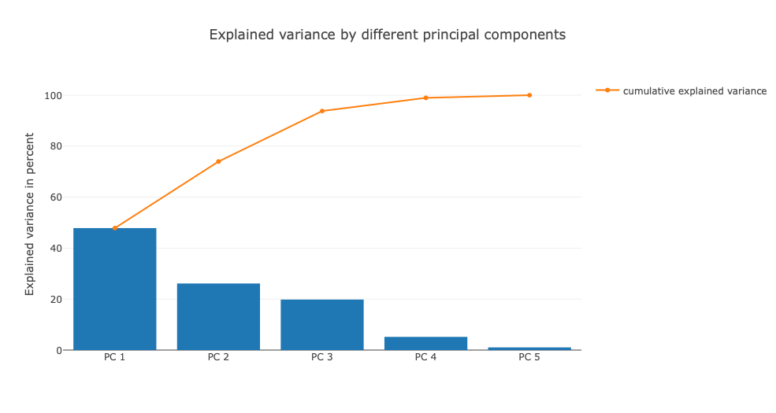
Principal Component Analysis:

Slide 12
RANDOM FOREST:
Divide 898 data into two parts train and test data:
Train has 628 and test has 270
On train data perform Bootstrap for 1000 times.
Calculate regression using 5 methods:
Y hat1 = alpha + beta1PC1 + beta2PC2 + beta3PC3
Y hat2 = alpha + beta1 X (X -> data of EU,AL,SZ)
Y hat3 = alpha + beta1PC1 + beta2ADS
Y hat4 = alpha + beta1ADS +beta2Y(t-1)
Y hat5 = alpha + Y(t-1)
Calculate the RMSE for test data and then choose the Y hat which has lowest RMSE.
Then after 1000 bootstrap we get 1000 Y hat and we calculate the average of it.
This is the final Y hat which we use for further calculations.
Calculate the standard deviation of the final Y hat and use this to draw Bollinger bands.

Slide 13
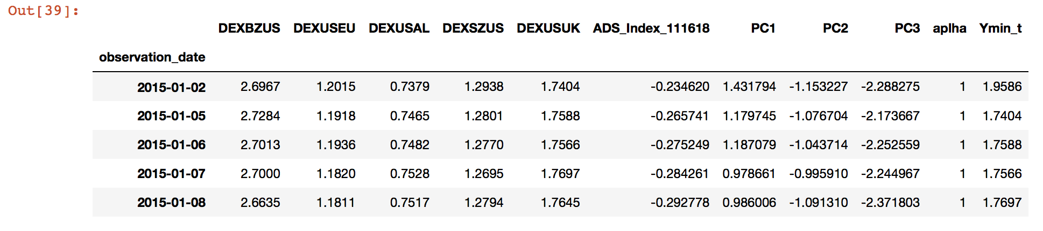
Data used for Random Forest:

Slide 14
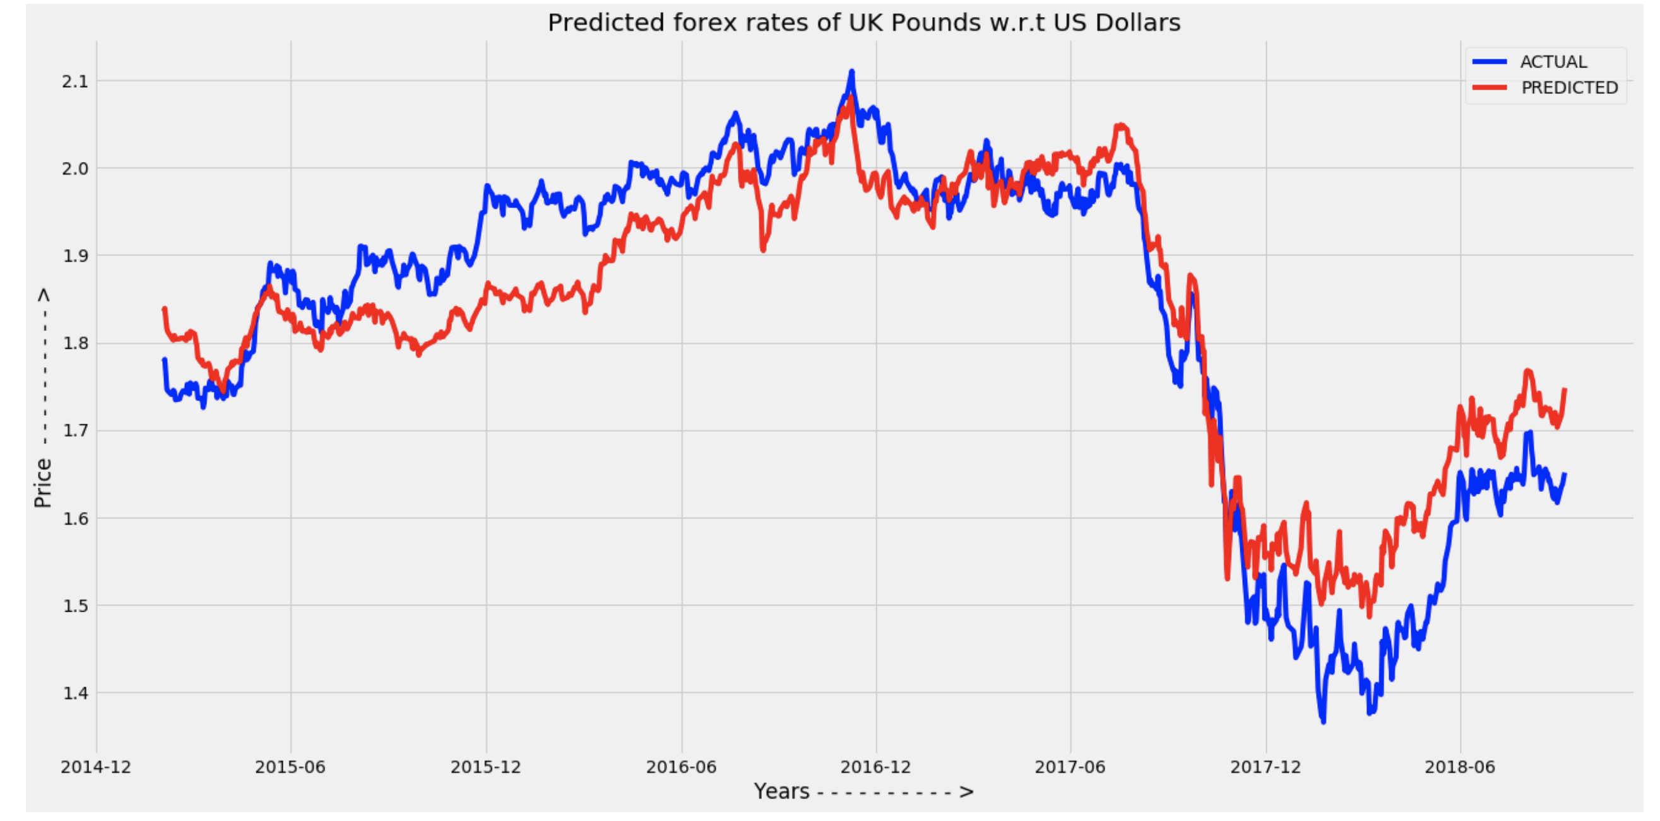
Random Forest Final Output:

Slide 15
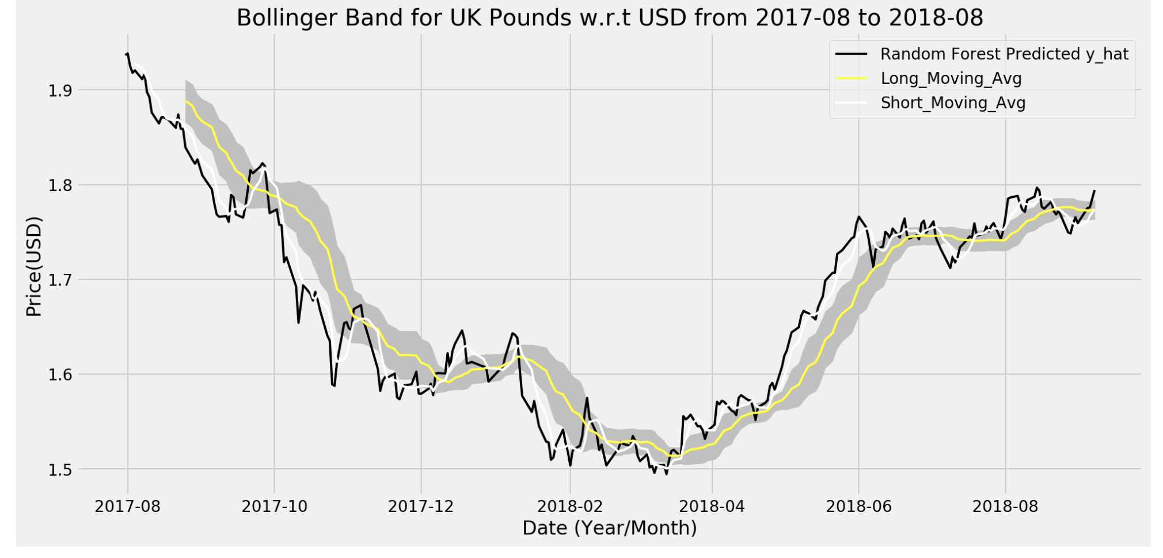
BOLLINGER BANDS

Slide 16
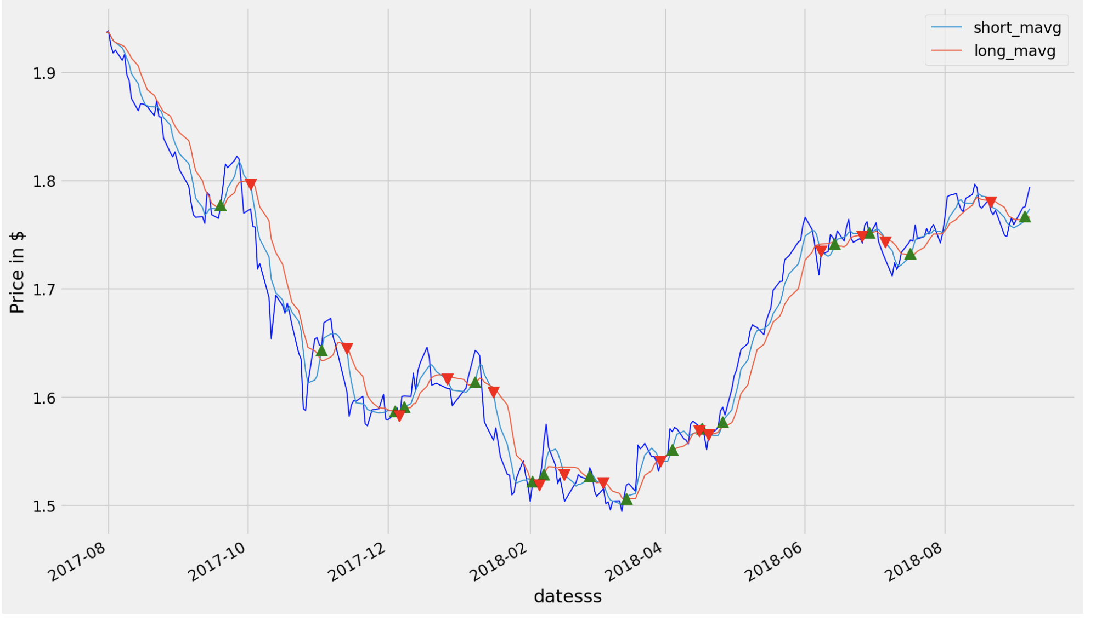
TRADING STRATEGIES
Double Cross-over:

Slide 17
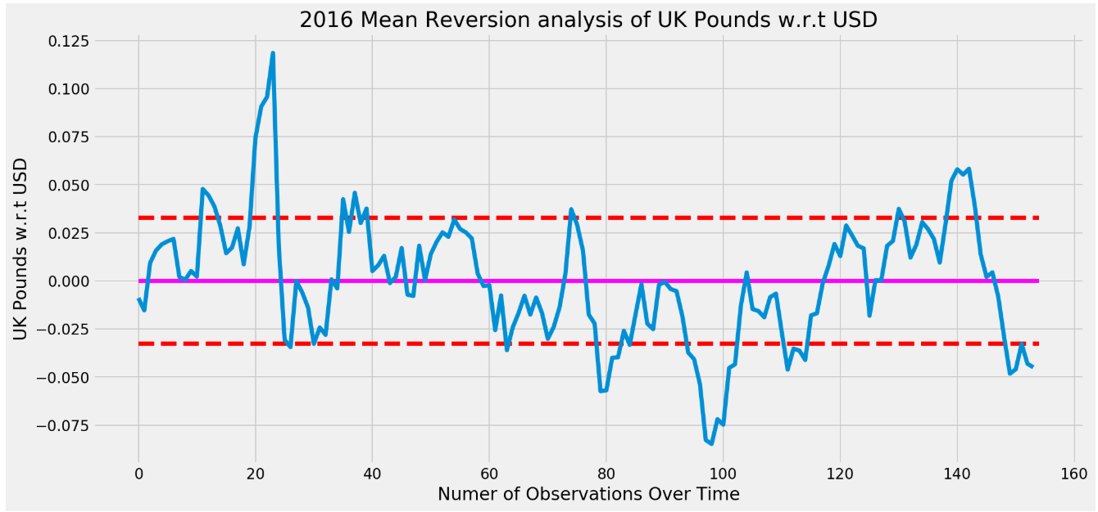
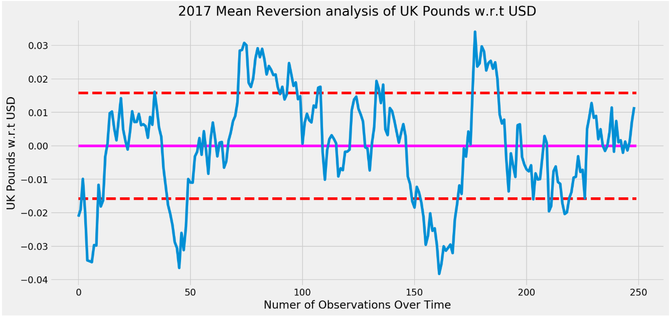
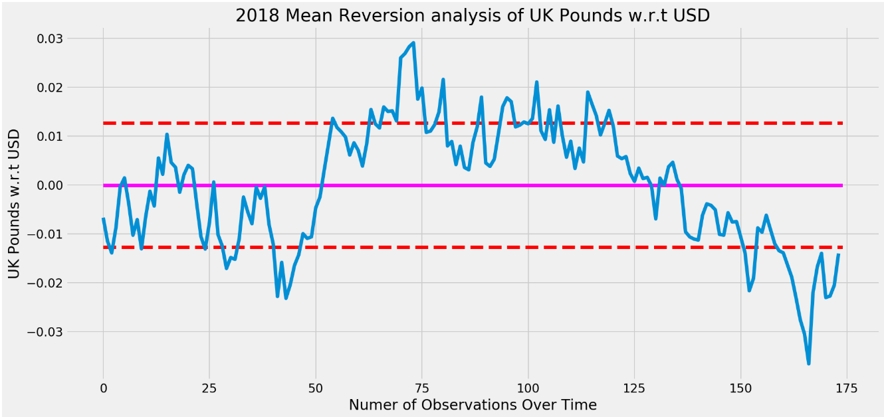
Mean Reversion Technique:

Slide 18
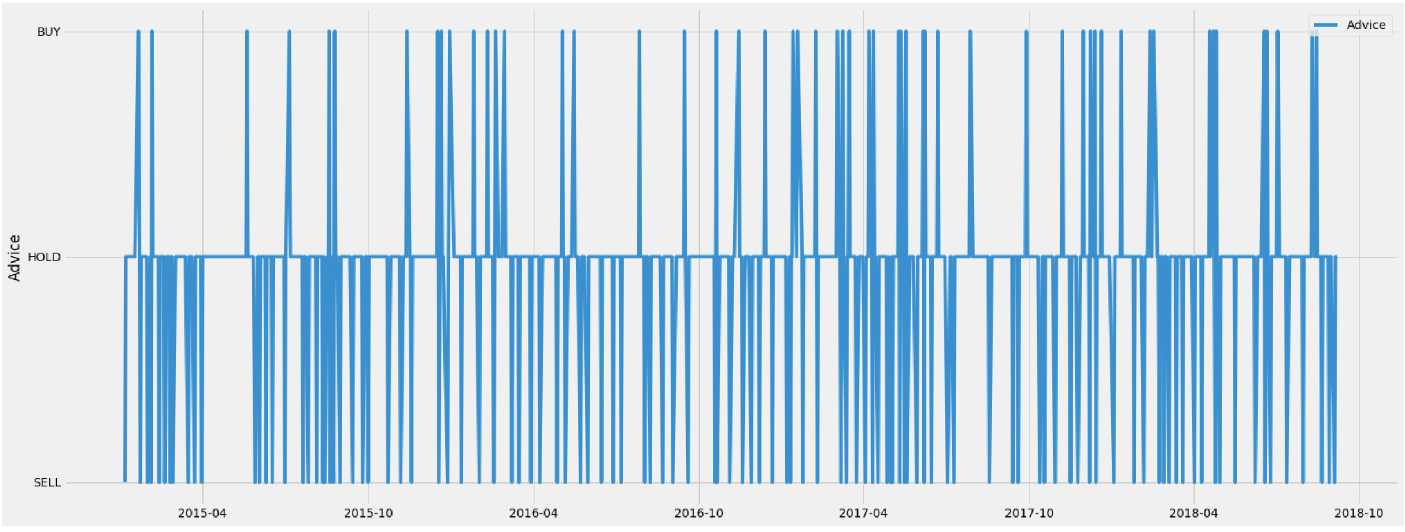
Trading signals:

Slide 19
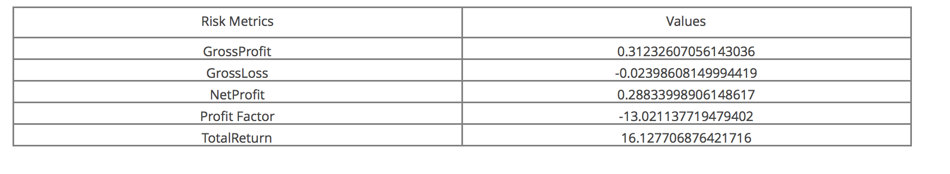
Profit And Loss:

